Slide 1

Exploratory Data Analysis
G2M Case
Feb-20-2024
Yan-Ping Yu

Slide 2

Agenda
Executive Summary
Problem Statement
Approach
EDA
EDA Summary
Recommendations

Slide 3
Executive Summary
Our client XYZ is a private equity firm in US. Due to remarkable growth in the Cab Industry in last few years and multiple key players in the market, it is planning for an investment in Cab industry.
By evaluating
transaction amounts
pricing strategies
cost and profit metrics
demographic segments
city-wise profit generation
the impact of payment methods
we will identify the most promising company for XYZ's investment.

Slide 4
Problem of Statement
The challenge is to analyze the market and identify which of the two cab companies, Yellow Cab and Pink Cab, presents a better investment opportunity based on various financial and operational metrics from 2016 to 2018.

Slide 5
Approach
Collect and Analyze Data
Formulate Hypotheses Within Categories
For Two Companies
．Merge Data
．Data Cleaning
．Data Visualization
．Compare the financial performance
． Segment customer demographics analysis
． Assess the impact of payment methods on transaction
03
Explore Available Data
Cab_Data.csv
Customer_ID.csv
Transaction_ID.csv
City.csv
02
01

Slide 6
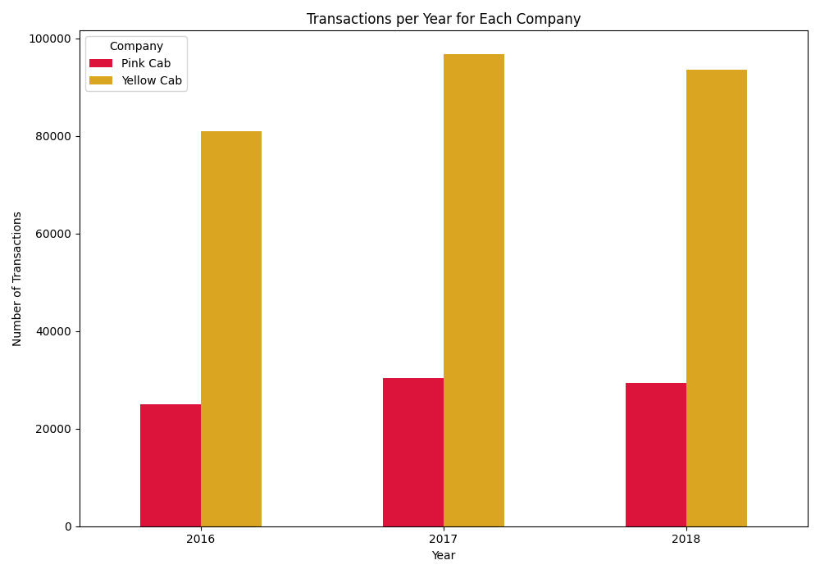
Transaction Analysis
Yellow Cab had approximately
60,000 more transaction amounts
on average than Pink Cab annually
Stronger market leadership
Potentially higher customer trust or preference
Potential for sustained revenue growth

Slide 7
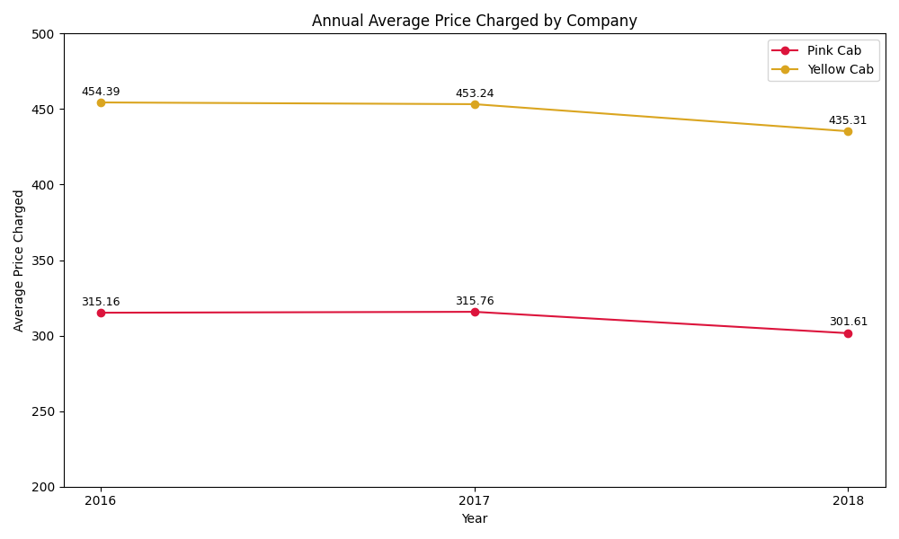
Pricing Analysis
On average, Yellow Cab charged
about $140 more per trip than Pink Cab
each year over the same period
Offer premium services
Higher pricing power and brand value
Stronger revenue generation capabilities

Slide 8
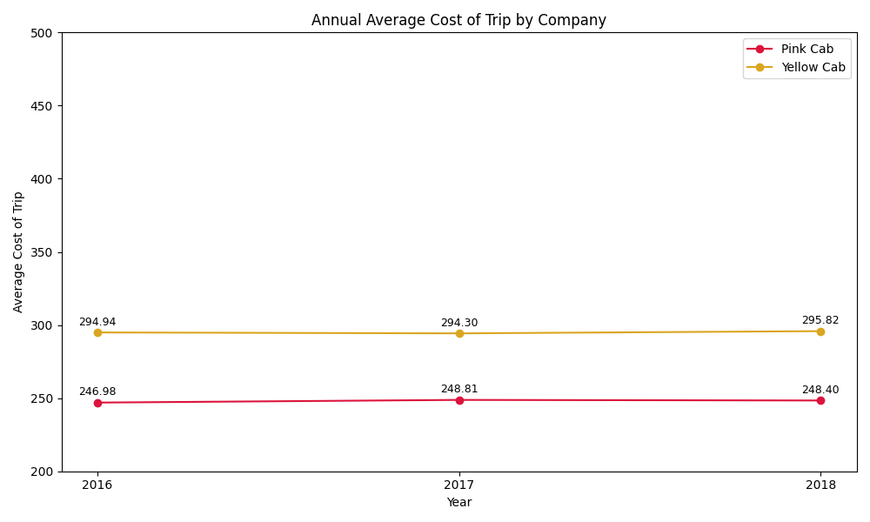
Cost Analysis
Annually, Yellow Cab's average cost per trip was about $50 higher than that of Pink Cab over the three years
Higher quality services
Need to manage costs effectively

Slide 9
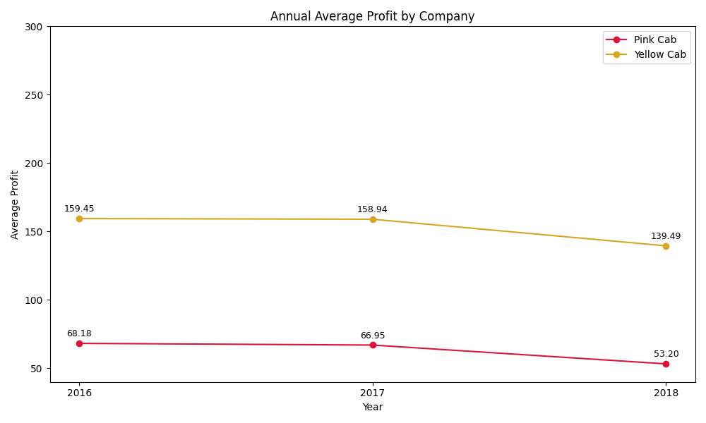
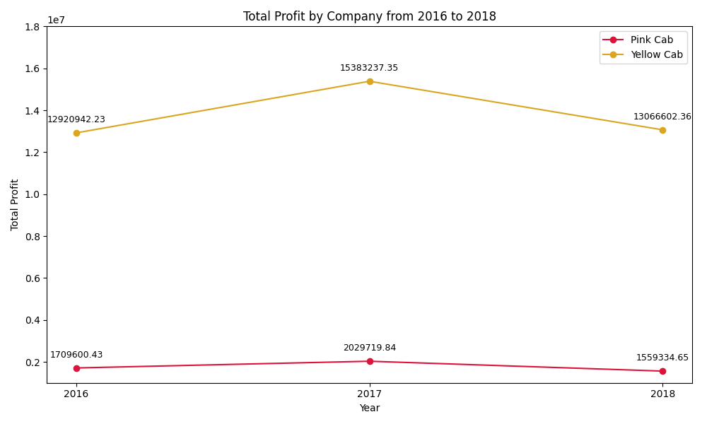
Profit Analysis
Yellow Cab's average profit per trip exceeded Pink Cab's by roughly $90 annually
Yellow Cab accumulated a total of $36 million more in profit than Pink Cab from 2016 to 2018
Better profitability per transaction
(likely due to its pricing strategy and market positioning)
Reinforcing its financial strength
Supporting a promising investment opportunity.

Slide 10
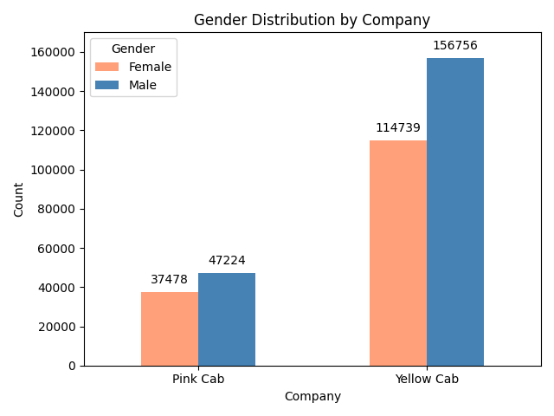
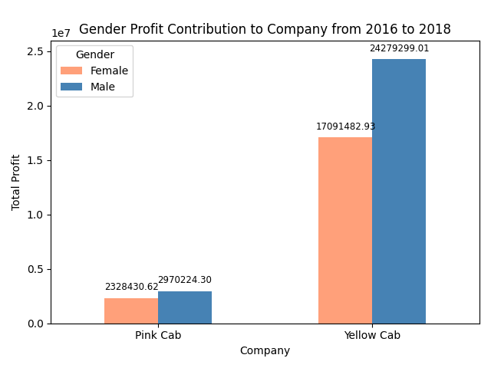
Customer Segments Analysis - Gender
Men: possibly more reliant on cab services for commuting or have a higher preference for the convenience of cabs
Women: may value safety, reliability, and cleanliness more highly in their transportation options
Yellow Cab served 77,000 more female and 110,000 more male customers than Pink Cab
Yellow Cab generated $14 million more from female customers and $21 million more from male customers compared to Pink Cab.
Notes:
More effective Marketing strategies, Business model (reliability, availability, pricing, and customer service quality), or pricing strategies to attract audience and generate profit irrespective of the customer's gender

Slide 11
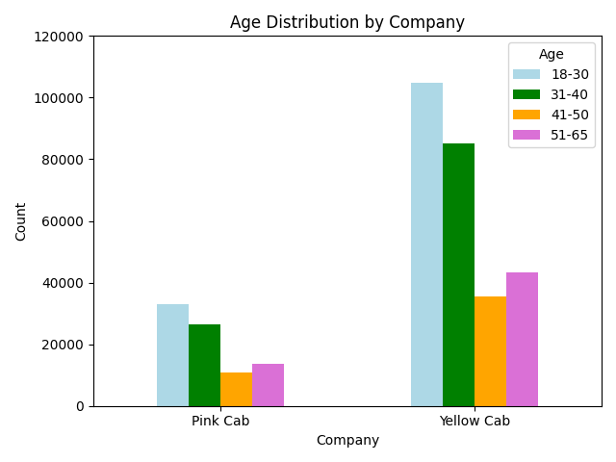
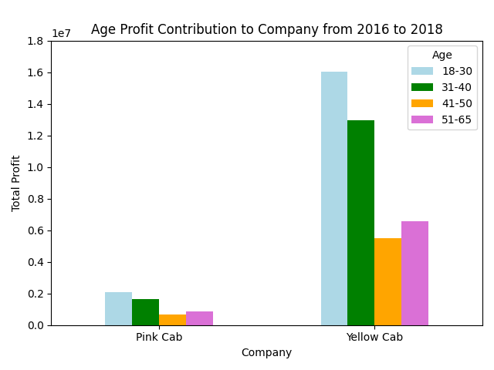
Customer Segments Analysis - Age
Younger adults: might have higher mobility needs and openness to ride-sharing services
Opportunity for expanding the middle-aged and older customer groups
Yellow Cab dominates in customer base and profits across all age groups,
especially among those aged 18-30, followed by the 31-40, 51-65, and then 41-50 age groups
Notes:
More effective Marketing strategies, Business model (reliability, availability, pricing, and customer service quality), or pricing strategies to attract audience and generate profit irrespective of the customer's gender

Slide 12
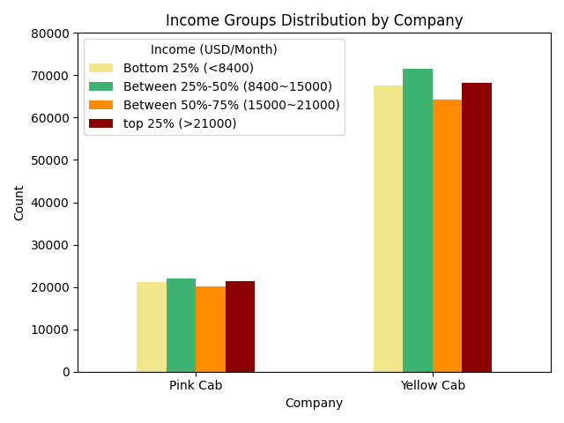
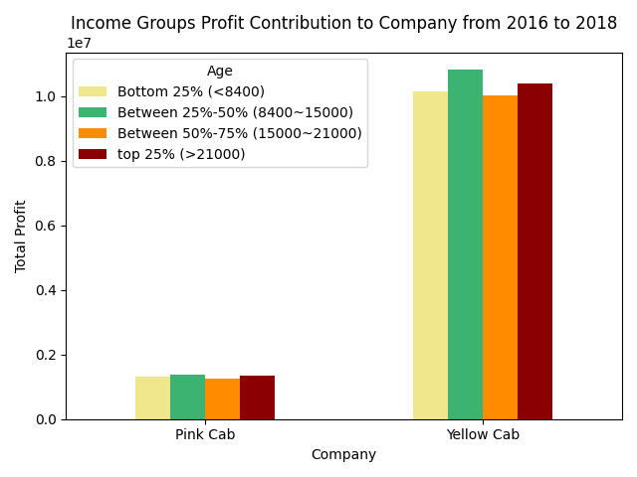
Customer Segments Analysis – Income Groups
For the 25%-50% bracket, competitive pricing and subscription models could ensure loyalty and frequent use.
Introduce or expand premium service options targeting high-income users
Yellow Cab dominates in customer base and profits across all income groups.
The majority of its customers are in the middle-income group,
with profit contribution mirroring this distribution.
Notes:
More effective Marketing strategies, Business model (reliability, availability, pricing, and customer service quality), or pricing strategies to attract audience and generate profit irrespective of the customer's gender

Slide 13
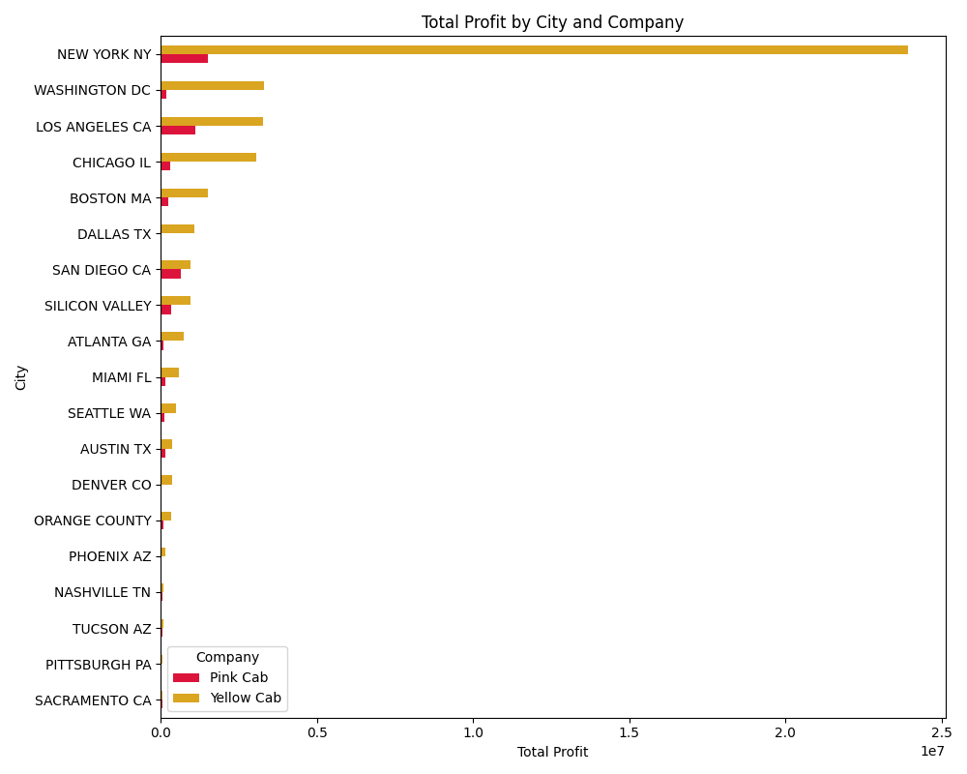
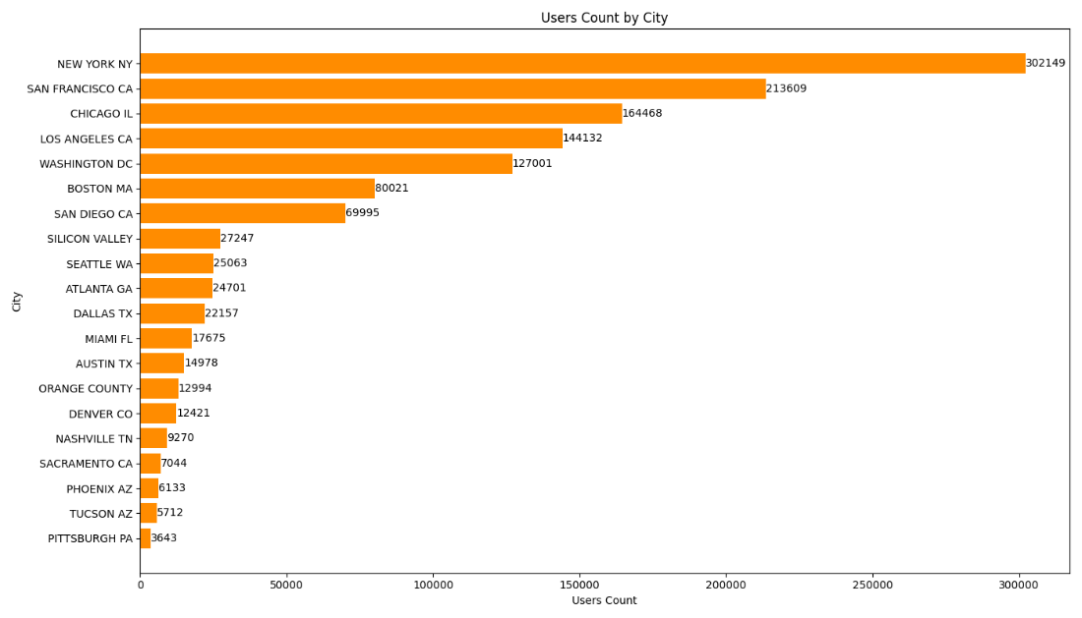
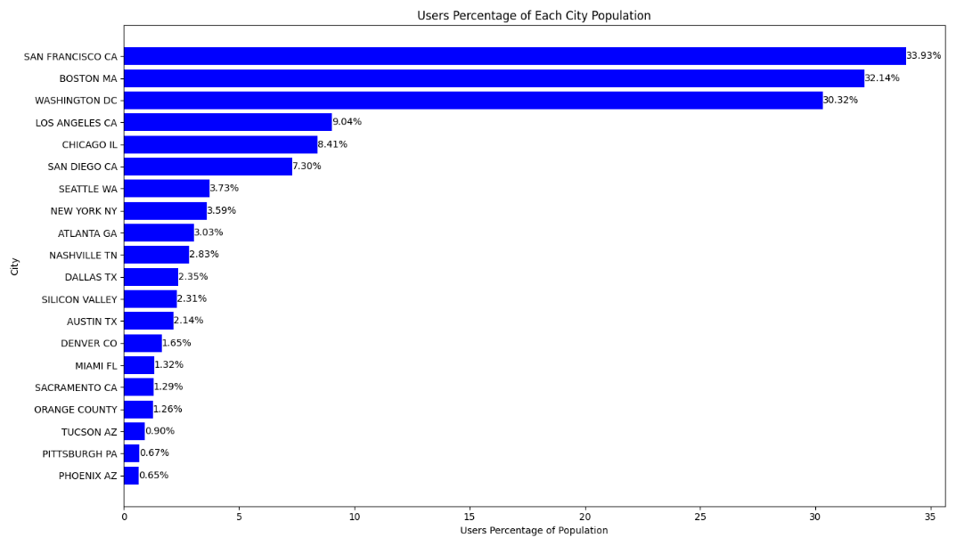
City Wise Cab Users Analysis

Slide 14
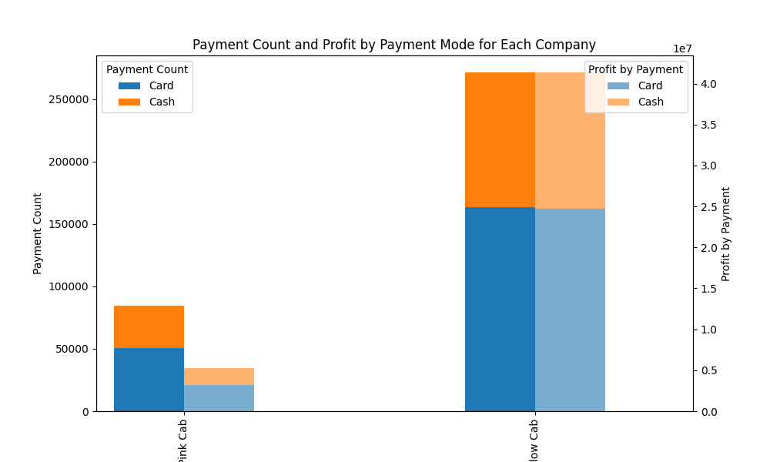
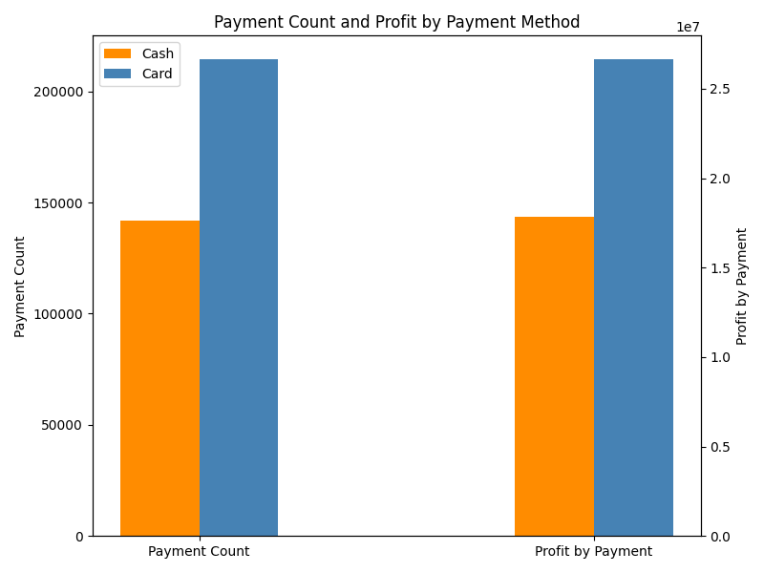
Payment Method Analysis
Payment method is not a major differentiator
but offering card payment options is essential

Slide 15
Recommendation
Market Leadership: Yellow Cab has higher transaction amounts from 2016 to 2018, demonstrating strong market presence and customer preference.
Financial Performance: Yellow Cab has a higher average profit per trip and overall profitability, suggesting a solid financial foundation and effective pricing strategy.
Broad Customer Base: Yellow Cab appeals to a wide demographic, indicating versatile service offerings that cater to diverse customer needs.
Strong Urban Presence: Yellow Cab's significant profit generation in major cities shows its successful penetration in high-demand urban markets, promising for future growth.
Payment Flexibility: The non-significant impact of payment method on profits suggests operational efficiency in handling transactions, appealing to customer convenience
On the basis of above points, we recommend Yellow Cab for investment

Slide 16
Thank You

